Slide 1
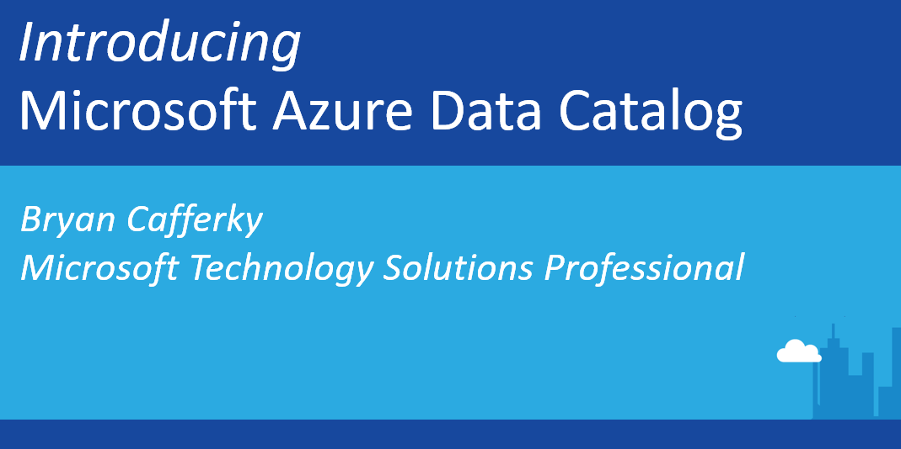


Slide 2


Introducing
Microsoft Azure Data Catalog
Bryan Cafferky
Microsoft Technology Solutions Professional
Microsoft Azure Data Catalog
https://github.com/bcafferky/shared/tree/master/AzureDataCatalog
https://github.com/bcafferky/shared

Slide 3

Recognize Any of These Challenges?
Users spend more time looking for data,
than they do analyzing it
Data is sitting in multiple sources, but no insight into which data sits where
Many different data ecosystems across the enterprise, but no way to share data artifacts across them
Need data consumption in multiple different tools, but no common way of enabling discovery and access to data sources across them
Users are busy re-producing data assets that already exist
No way of tracking usage of our BI and Analytics assets

Slide 4
What is Azure Data Catalog?
An enterprise-wide directory in Azure that enables self-service discovery of data from any source
An enterprise-wide catalog in Azure that enables self-service discovery of data from any source
A metadata repository that allow users to register, enrich, understand, discover, and consume data sources

Slide 5
Publish
What Can I Do With It?
Publisher
Consumer
IT Admin
Discover
Govern
Register Data Sources
Browse - Search
Apply Policies - Control Catalog Access
Enrich
Understand
Analyze
Categorize – Annotate
Get context – Identify Intent
Extend

Slide 6
Demo
https://azure.microsoft.com/en-us/services/data-catalog/

Slide 7
Azure Data Catalog Glossary – Paid Edition Only
Hospital
Facility
Location
Entity
Standardizing Business Terms

Slide 8
Data Catalog Free Edition
Enroll any number of users in your organization and get started using the free edition
Enjoy a full end-to-end experience of using the Azure Data Catalog service
Allow any user to register, enrich, understand, discover, and consume data from sources registered with the Data Catalog
→ The Free Edition is an open system, where any asset registered is visible to every authenticated user
$

Slide 9
Data Catalog Paid Edition
Scale the Enterprise with Increased Data Governance using Paid Edition
Allow users to take ownership of registered assets for greater control
Enable asset-level authorization restricting visibility and ability to annotate registered assets to a limited number of users as needed
Glossary Support
The Paid Edition is a governed system, providing central control and IT oversight
$
Notes:
Paid Edition Capabilities include:
Taking ownership of an asset
Asset-level authorization
Business Glossary

Slide 10
API
REST based API using JSON payload
Allows Registration, Update, and Delete of assets
Allows Create, Update, Delete of annotations
Allows Rich search syntax
Full-text search and exact match
cross asset or scoped to a property
Notes:
Samples: https://azure.microsoft.com/documentation/articles/data-catalog-samples/

Slide 11
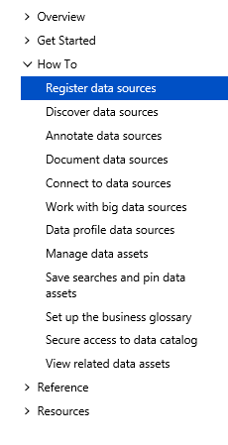
Azure Data Catalog Process
https://docs.microsoft.com/en-us/azure/data-catalog/data-catalog-how-to-register

Slide 12
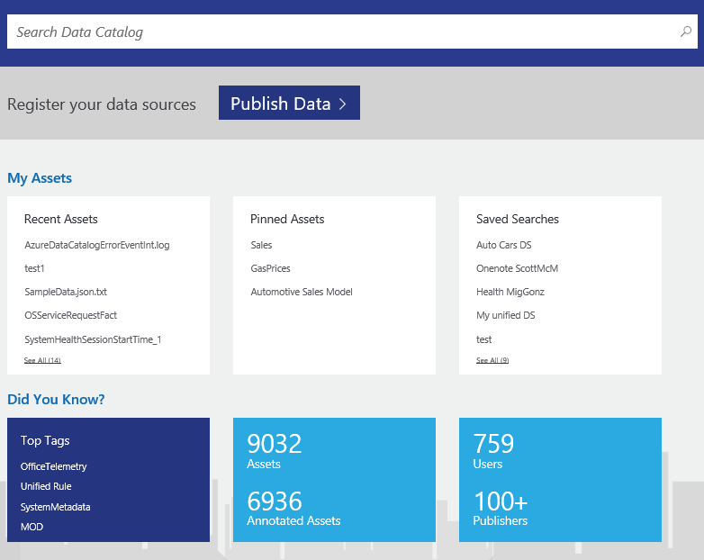
Home Page
Primary action is discovery of datasets with ‘Search’ front and center
Quick jump-offs to recent datasets, pinned assets as well as saved search queries
Quick analytics showing catalog-level usage

Slide 13
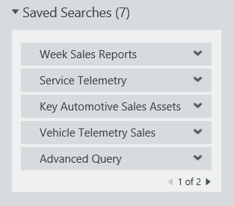
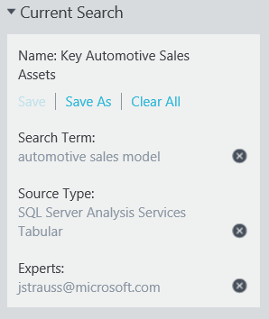
Saved Searches
Define search criteria
Add search terms
Add tags and other filters
Save and name for later reuse
Mark one saved search as default
Running saved search always returns current results
Select from Home page
Select from Discover page
Notes:
https://azure.microsoft.com/en-us/documentation/articles/data-catalog-how-to-save-pin/

Slide 14
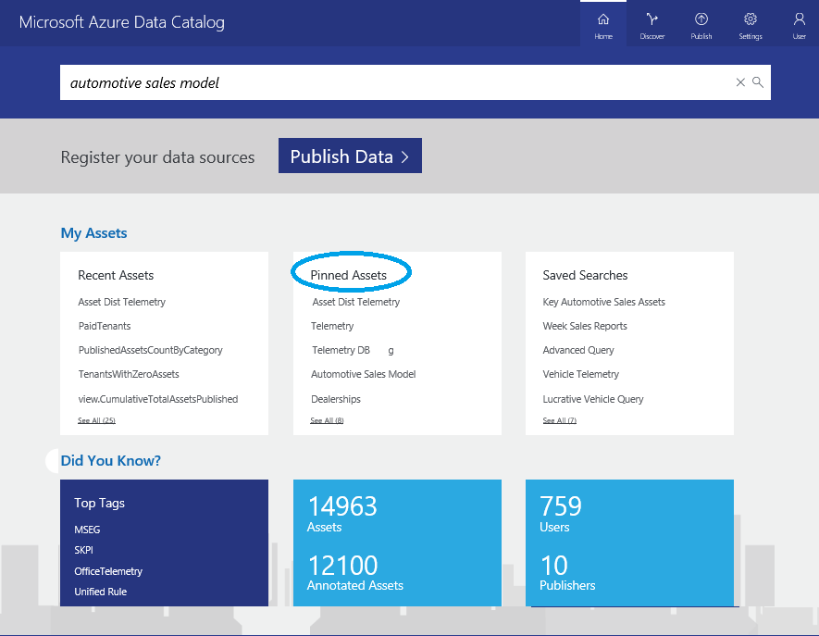
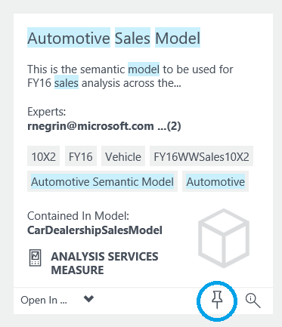
Pinned Assets
Pin frequently-used assets and containers to your home page
Pin and unpin data assets from Discover page
View, use, and manage pinned data assets from Home page
Notes:
https://azure.microsoft.com/en-us/documentation/articles/data-catalog-how-to-save-pin/

Slide 15
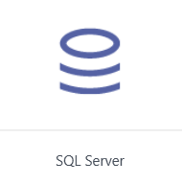
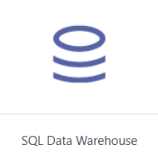
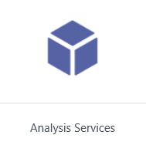
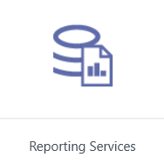
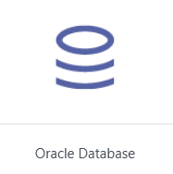
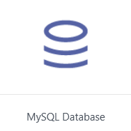
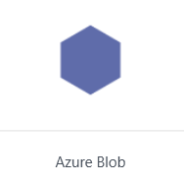
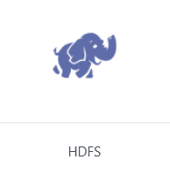

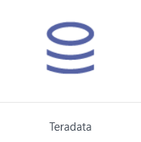
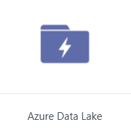
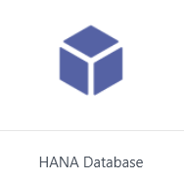
Data Sources
Supported for automatic metadata extraction

Slide 16
Supported Data Sources
Supported via manual entry
Additional Data Sources supported via manual entry
PostgreSQL
OData
SharePoint
HTTP
File System
DB3

Slide 17
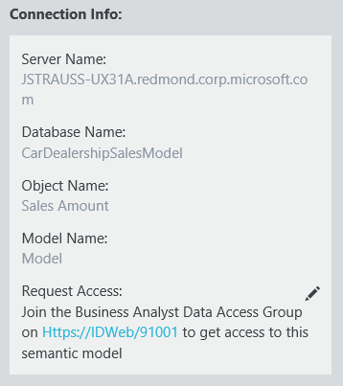

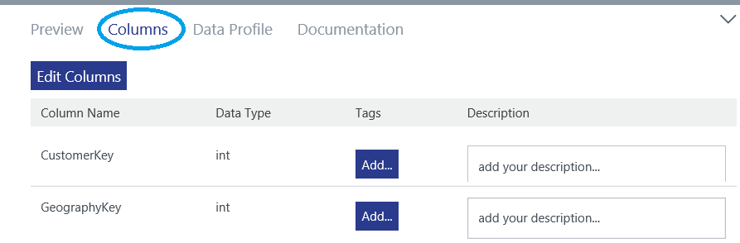
Annotations – Technical Metadata
Technical metadata
Automatically extracted from data sources during registration
Manually entered in Data Catalog portal
Data source location – information needed to connect
Object names and types
Attribute names and types
Data types and related details

Slide 18
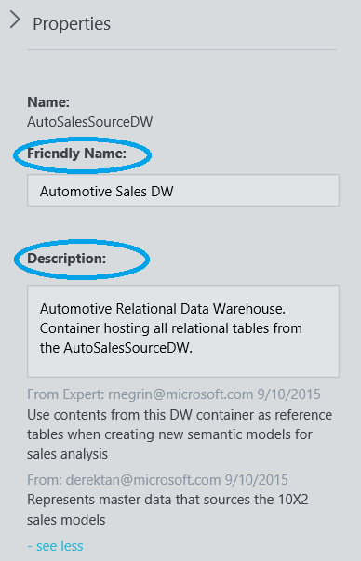

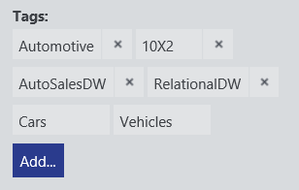
Annotations – Business Metadata
Business metadata
Supplement automatically extracted metadata with business knowledge
Manually entered in Data Catalog portal
Friendly name
Descriptions
Tags
Experts
Object-level and attribute-level information

Slide 19
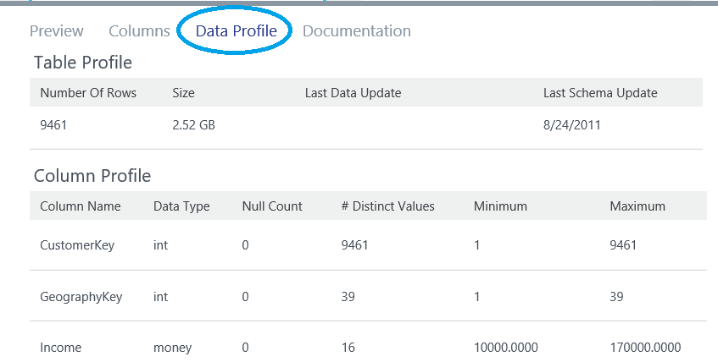
Data Profiling
Data profile statistics for supported data sources
SQL Server, including Azure SQL DB and SQL DW
Oracle
Teradata
Hive
Selected during data source registration
Object-level profile
Size
Row count
Attribute-level profile
Min, max, average, and standard deviation
Null count and distinct value count

Slide 20
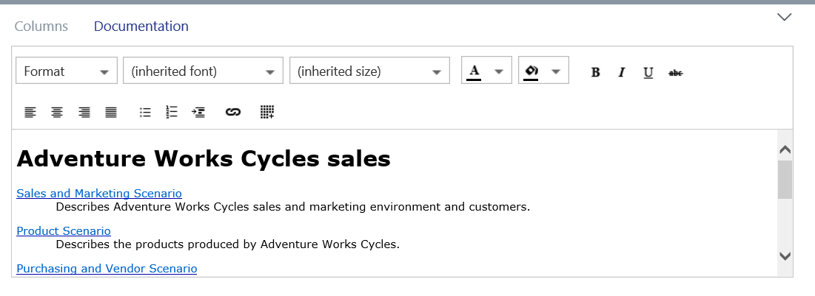
Asset Documentation
Rich text documentation for data assets and containers
Entered via Data Catalog portal
Complements descriptions, tags, and other descriptive metadata

Slide 21
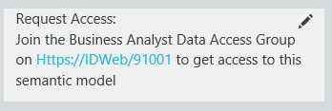
Request Access
Unblock users who discover data assets
Integrate in with existing tools and processes
Include instructions inline with connection info
Link to individuals or teams who manage data source access
Link to existing process documentation
Link to self-service identity management tools like Forefront Identity Manager

Slide 22
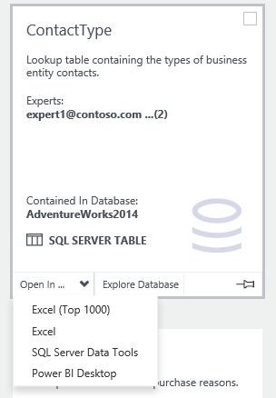
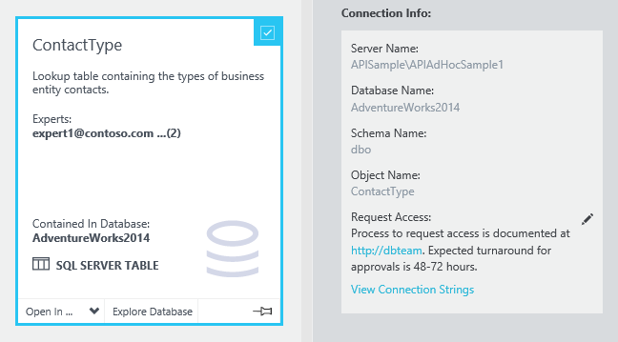
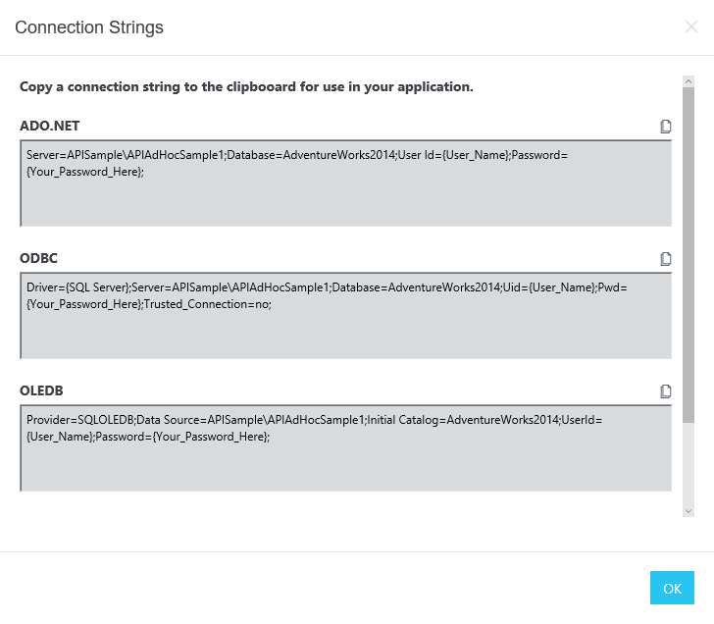
Contextual Asset Consumption
Users can open selected data assets in supported client applications
Data asset properties include complete connection information for use in any client application
Pre-built connection strings are available for data developers

Slide 23

The End
https://docs.microsoft.com/en-us/azure/data-catalog/data-catalog-get-started

